Slide 1
Planet validation data and sensitivity analysis of timeseries method
May 10, 2019

Slide 2
Planet imagery

Slide 3
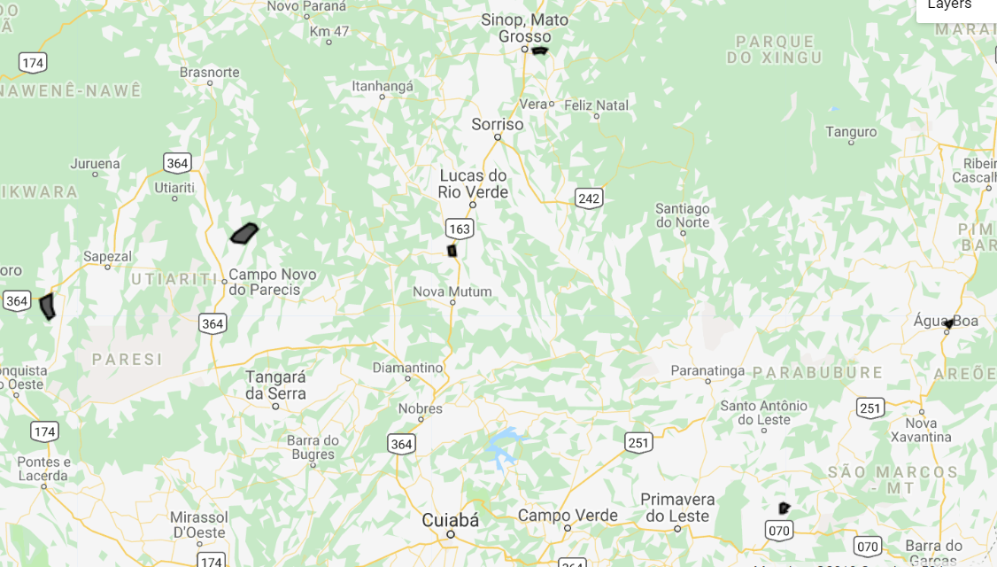
New MT location to download Planet
The locations of these polys are based on on soy_pts_agsat1, so only download for 2016-2017. Try to go for about 30 to 40 fields in different locations instead of 80 fields in a single location because of potential bias due to cloudy days
In MT, look at a place with SC (based on agsat training) and download for a place with known SC – useful for seeing accuracy of classifying SC
Download all of these in for 2016- 2017
Order of priority: poly 11 (has SC), poly 12, poly 14, poly 13, poly 15
Poly 12
Poly 5
Poly 15
Poly 13
Poly 14
Poly 11 (has SC)
Poly11 was ordered and downloaded on April 4.
Poly12 was ordered and downloaded on May 7.

Slide 4
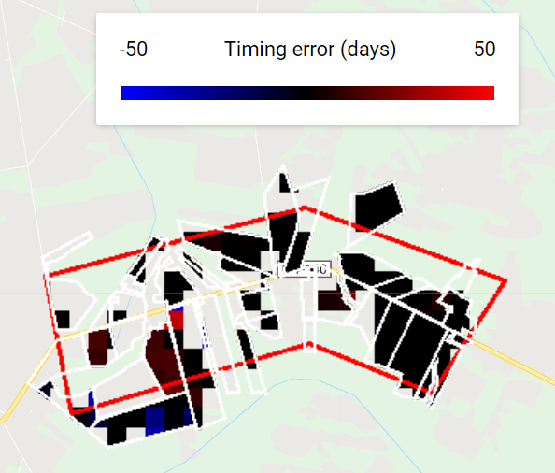
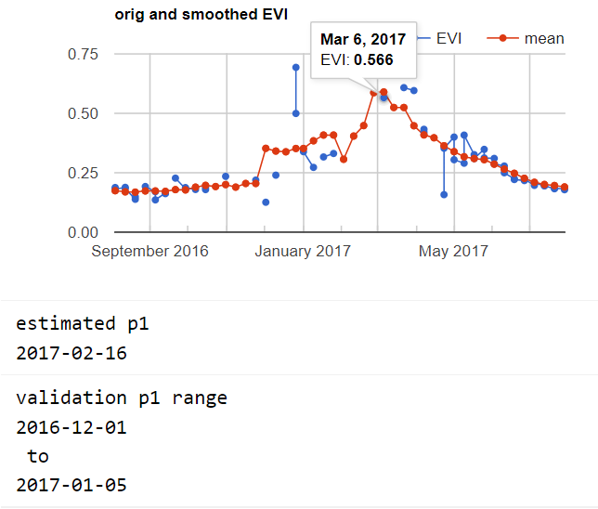
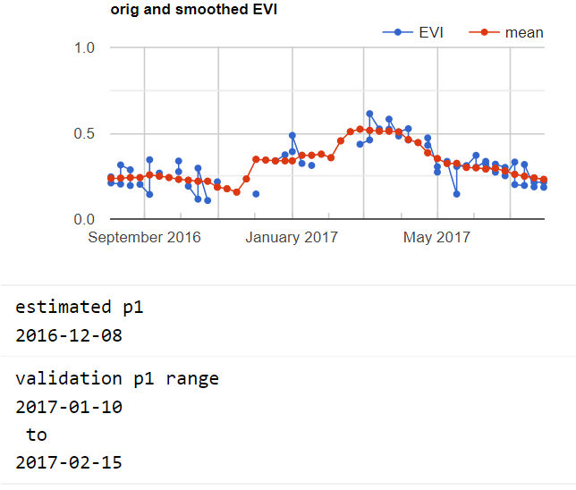
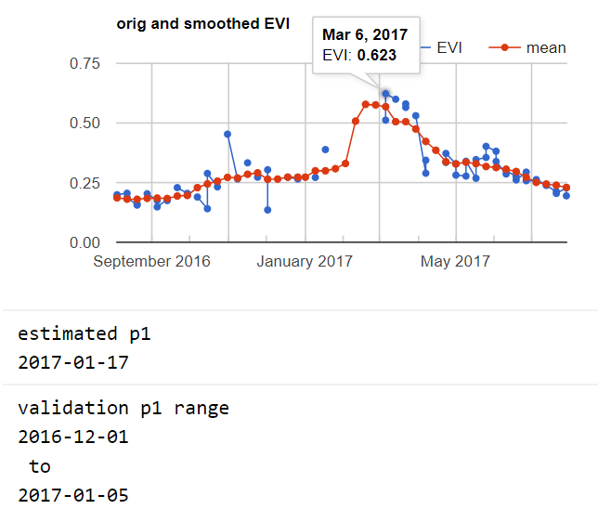
Poly12 validation
Plant1 error
Found the wrong peak
Unsure where the peak is…
The estimate and validation planting dates are both reasonable
GEE file: Planet Do Validation v2

Slide 5
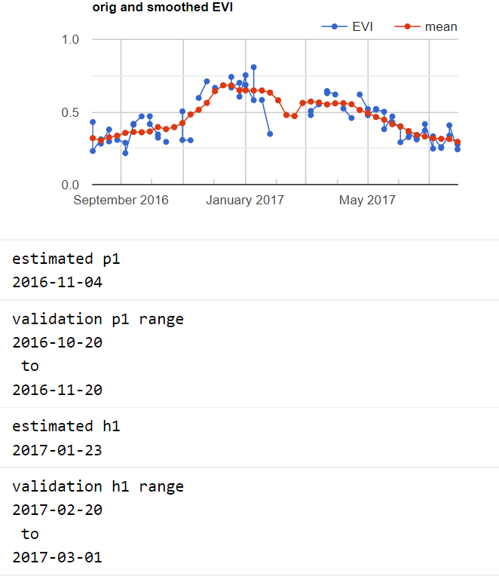
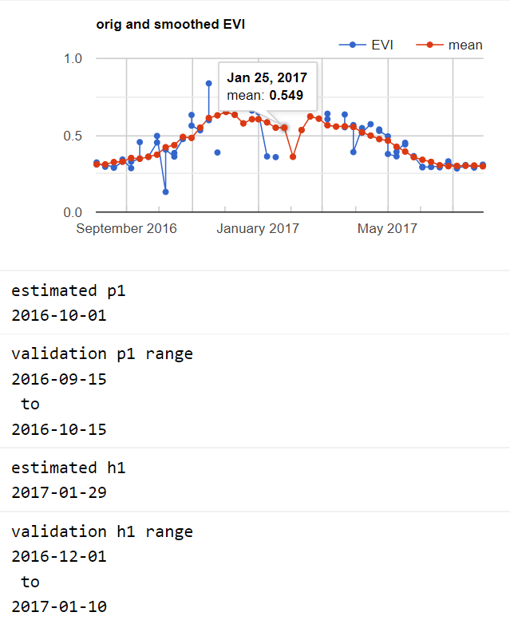
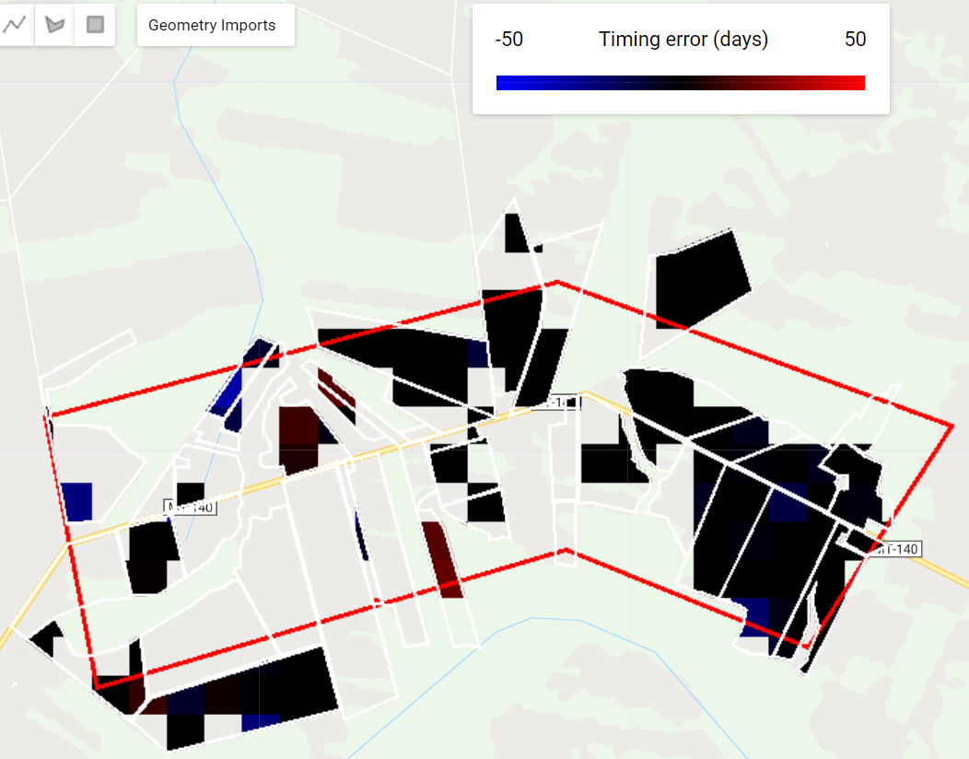
Poly12 validation
Harvest1 error
The estimate of harvest1 actually seems more reasonable than the validation, based on EVI TS
Both the estimated and validation harvest1 seem reasonable based on the EVI timeseries
Takeaways
Ambiguities in the timeseries creates error (i.e. large gaps, noise, and weird trajectories that don’t look like crop)
Sometimes the estimate makes more sense than the validation data
GEE file: Planet Do Validation v2

Slide 6
Timing algorithm sensitivity check

Slide 7
Code workflow for sensitivity analysis
Timeseries_Sensitivity/Sensitivity
Input the timeseries analysis parameters, like peak cutoff date, moving window sizes for EVI smoothing and dEVIdt smoothing, and planting and harvest calibration equations
Read in Planet validation data, MODIS data, etc
Calculations:
TS analysis like in TS_Analysis_v10 as a function (ModisPhenology/FullTimeseriesAnalysis.js)
Calculate plant and harvest dates (using existing function)
Calculate validation results from Planet data (like in Planet Do Validation), except calculate summaries of error rather than just showing a map of pixel scale error
Function repo: ModisPhenology/FullTimeseriesAnalysis.js
For a harvest year, calculates phenology parameters
Function repo: CropTimingFunctions/CropTiming.js
Calculate the planting and harvest dates. New function: estimatePlantHarvest_sensitivity (to allow for different calibration equations from peak/quarter period to crop calendar)
Function repo: PlanetValidationFunctions/DoValidation.js
Given timing validation data and crop calendar estimate image, calculate average error and show the errors on a map
Note: in comparing the original doubleCropTiming_full asset to the in-situ generated timeseries_result_image of file Sensitivity, there are small differences because the asset was exported as full pixels while the in situ image was masked with mapbiomas
Default parameter values:
peakCutoff = ‘-04-01’
Window_EVI_1 = 20
Window_EVI_2 = 30
Window_dEVI = 50
Planting_param = 1.5
harvest_param = 1

Slide 8
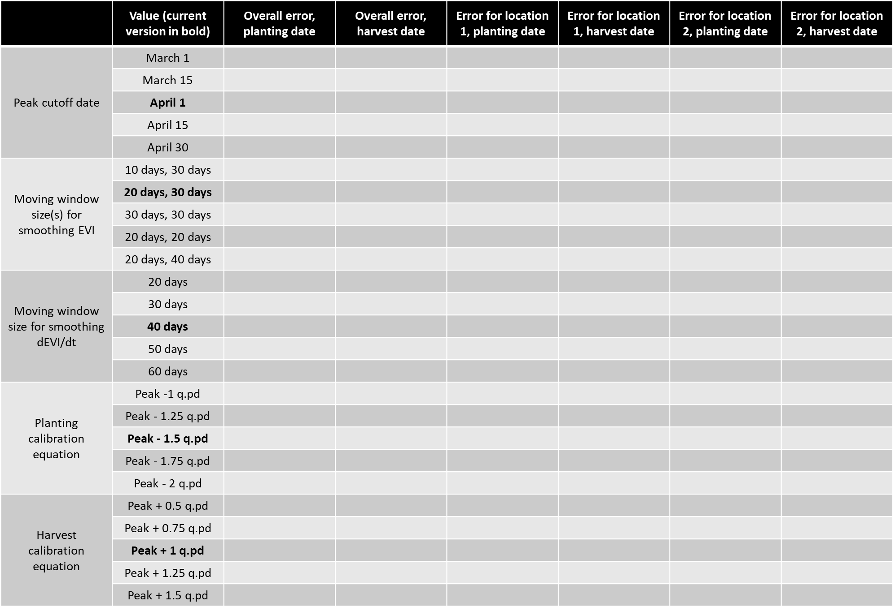
Sensitivity analysis parameters (absolute value of range Error), everything else is set at default value
 | Value (current version in bold) | Overall error, planting date | Overall error, harvest date | Error for poly5, planting date | Error for poly5, harvest date | Error for poly11, planting date | Error for poly11, harvest date | Error for poly12, planting date | Error for poly12, harvest date
Peak cutoff date | March 1
 | March 15
 | April 1
 | April 15
 | April 30
Moving window size(s) for smoothing EVI | 10 days, 30 days
 | 20 days, 30 days
 | 30 days, 30 days
 | 20 days, 20 days
 | 20 days, 40 days
Moving window size for smoothing dEVI/dt | 20 days
 | 30 days
 | 40 days
 | 50 days
 | 60 days
Planting calibration equation | Peak -1 q.pd
 | Peak - 1.25 q.pd
 | Peak - 1.5 q.pd
 | Peak - 1.75 q.pd
 | Peak - 2 q.pd
Harvest calibration equation | Peak + 0.5 q.pd
 | Peak + 0.75 q.pd
 | Peak + 1 q.pd
 | Peak + 1.25 q.pd
 | Peak + 1.5 q.pd

Slide 9
Next

Slide 10
Crop timing
For natural vs agri accuracy, try masking edges and masking by crop cycle and peak EVI target only agri
Look at the dates corresponding to the low error fields and see if they represent the full range of crop dates represented by all the fields, because there might be a bias towards fields that were planted at a time when there weren’t clouds. This bias would also be solved if there are many locations of validation data.
Check QA/QC for the small peak before the larger peak (base threshold off places we know are DC and what the peak height is),
Robustness checking of timeseries analysis: how would plant, harvest results be different if (1) smooth EVI timeseries more or less; (2) smooth the 1st derivative more or less; (3) pick another cutoff date for first vs second peak? Choose the best combo based on Planet validation data; if no clear winner, report all versions.
Attach error distributions to crop timing estimates
At pixel and field/aggregated scale
Based on width of validation range and ‘range error’
Do all pixels/cells have the same error?
Separate errors for p1, (h1 + p2), and h2 (due to likelihood of clouds impacting TS analysis)
NEXT Planet image downloads:
For poly6 to 15 (based on soy_pts_agsat1), only download for 2016-2017. these are in MT – try to go for about 30 to 40 fields in different locations instead of 80 fields in a single location because of potential bias due to cloudy days
Colab: best way to use Python API with GEE (ipython notebook server)
Do pip install earthengine-api in colab to get virtual machine
Import ee
ee.Initialize()
ee.batch.Task.list() – proves can use earth engine
Docs: github/earthengine-api -> python -> examples -> ipynb -> example stuff

Slide 11
Planet imagery workflow
Uploading planet images as GEE asset
Properties of each image in PlanetLabs folder
Year, Month, Day, Satellite
PS_analytic_4band
RE_ortho_analytic
PS_ortho_analytic
PS_scene_analytic
Asset name is same as the description used in downloading from Planet web site
Lookup table in desktop has Planet order number and description and GEE asset name
Step | To do | Script/web site
1 | Find locations, years where Planet images are needed. Keep info on shp name, image name(s), and dates downloaded in Image_Lookup file in Google Drive | GEE: LandCover/Planet Image Selection
2 | Download cloud free, high temporal resolution Planet images (may need to pare down on locations, years) | Planet web site. Keep downloaded images in desktop
3 | Upload images as GEE assets | In desktop, keep tabs on asset id, polygon name, etc.
4 | Delineate individual fields, natural veg, agri, urban (houses) and center pivot in Planet imagery, and export as asset into the folder Planet Validation Data. The difference between fields and agri is that the fields contain individual (usu square) fields for timing observation purposes, whereas the agri contains lumped agri for land classification (natural vs agri) purposes. Assets are exported as ‘raw_agri_fc_poly1_year’, etc. need to turn delineated geometries into feature collections in order to export. | GEE: LandCover/Planet manual Field Delineation or Planet OBIA
5 | First import the Planet images and make custom visualizations for each, and map each with its own custom vis. Step through fields in CAR poly and record observed crop timing, export observations as feature collection to asset. Assets are exported as ‘timing_obs_for_polyName_in_year_part#’. Make sure to change the ‘part#’ BEFORE entering obs! 0 for SC, 1 for DC, 3 for TC or DC + failed first crop (2 is other agri in Jake’s classification) Remember to save the custom visualizations for the images in that polygon in Common Assets script | GEE: Planet Create Validation Data v3
5.5 | (for poly1, poly3, and poly5), go back to the timing validation data exported from Planet Create Validation Data v2 and add ‘confidence level’ for my crop timing and crop intensity validation dataset; use MODIS TS to help replace previous crop intensity classification. For confidence labels, use -1 for no data (i.e. no second crop); 0 for no confidence; 1 for confident | GEE: Planet Add QA for Validation Data
6 | Import timing and land cover feature collections. May need to combine timing feature collections into a single fc. Turn feature collection of observations into validation image (might need to first merge multiple obs fcs into a single one), use to do validation. The following are turned into dictionaries of images (or simply images): the observed plant/harvest times; the observed cropping intensity; the observed land cover (agri - 10, center pivot - 20, natural - 30, urban – 40). Use images to do validation of timing and land cover maps. | GEE: Planet Do Validation

